Slide 1
Document-Aware Conversational Assistant
A RAG-Based Question Answering System
Course: Natural Language Processing
Ishan srivastava
Northeastern University

Slide 2

Problem Statement
Users struggle to efficiently extract information from long documents
Keyword-based search suffers from vocabulary mismatch
Manual reading is time-consuming and inefficient
Documents do not support conversational follow-up questions
There is a need for an NLP-based semantic question answering system

Slide 3
What This Project Is About
This project builds an intelligent system that allows users to chat with their own documents
Instead of keyword search, the system understands the semantic meaning of text
Users upload PDFs and ask questions in natural language
The system retrieves relevant document sections and generates answers from them
The goal is to demonstrate practical application of core NLP concepts

Slide 4
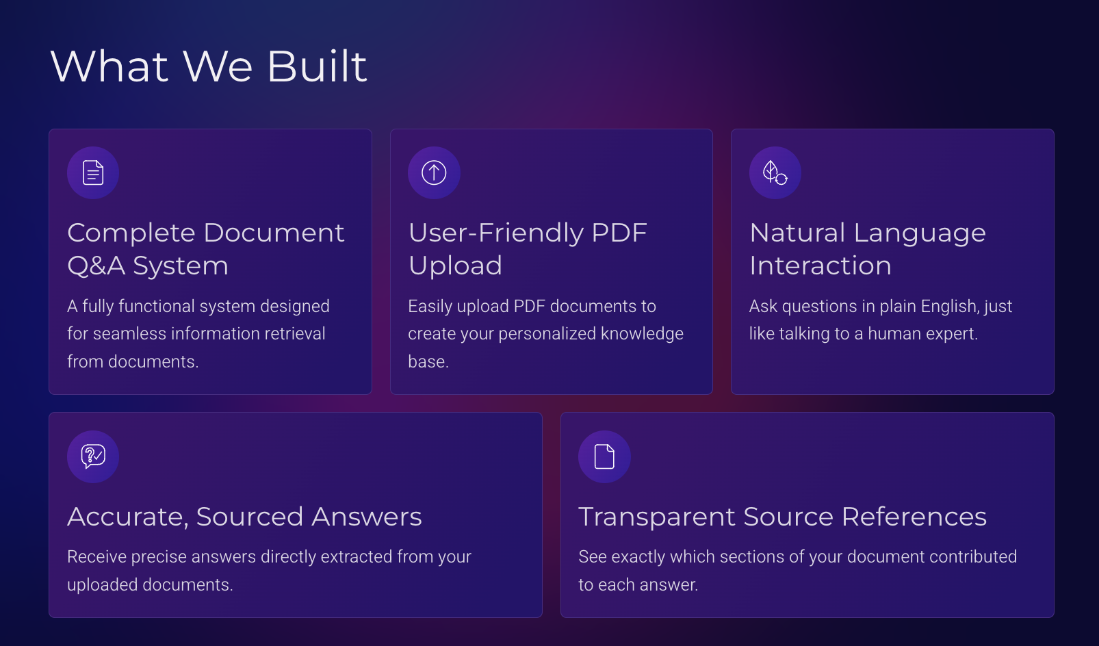

Slide 5
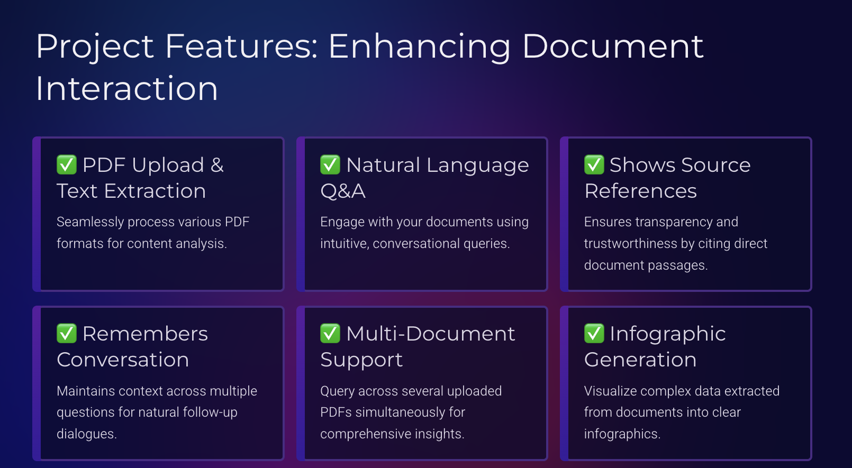

Slide 6
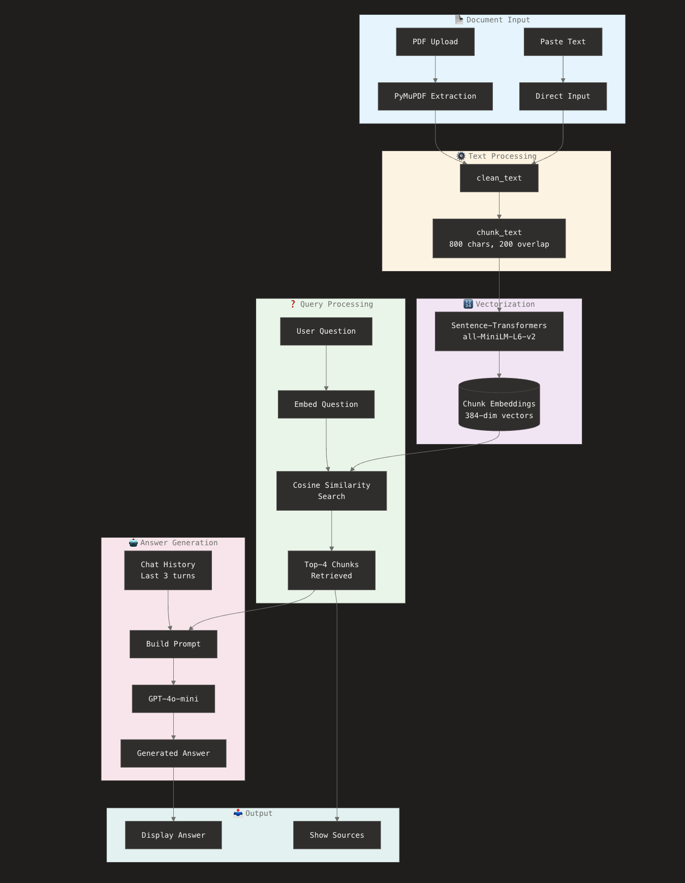

Slide 7
What Is Retrieval-Augmented Generation (RAG)
RAG combines information retrieval with text generation
Relevant document content is retrieved before generating an answer
The language model does not rely only on its internal knowledge
This grounds answers in actual document data
RAG is widely used in modern NLP systems like ChatGPT with files

Slide 8
Why RAG Instead of Pure LLM QA
Pure LLMs may hallucinate answers not present in documents
RAG ensures answers are based on retrieved content
Improves factual correctness and transparency
Allows document-specific question answering
LLM is Generalized

Slide 9
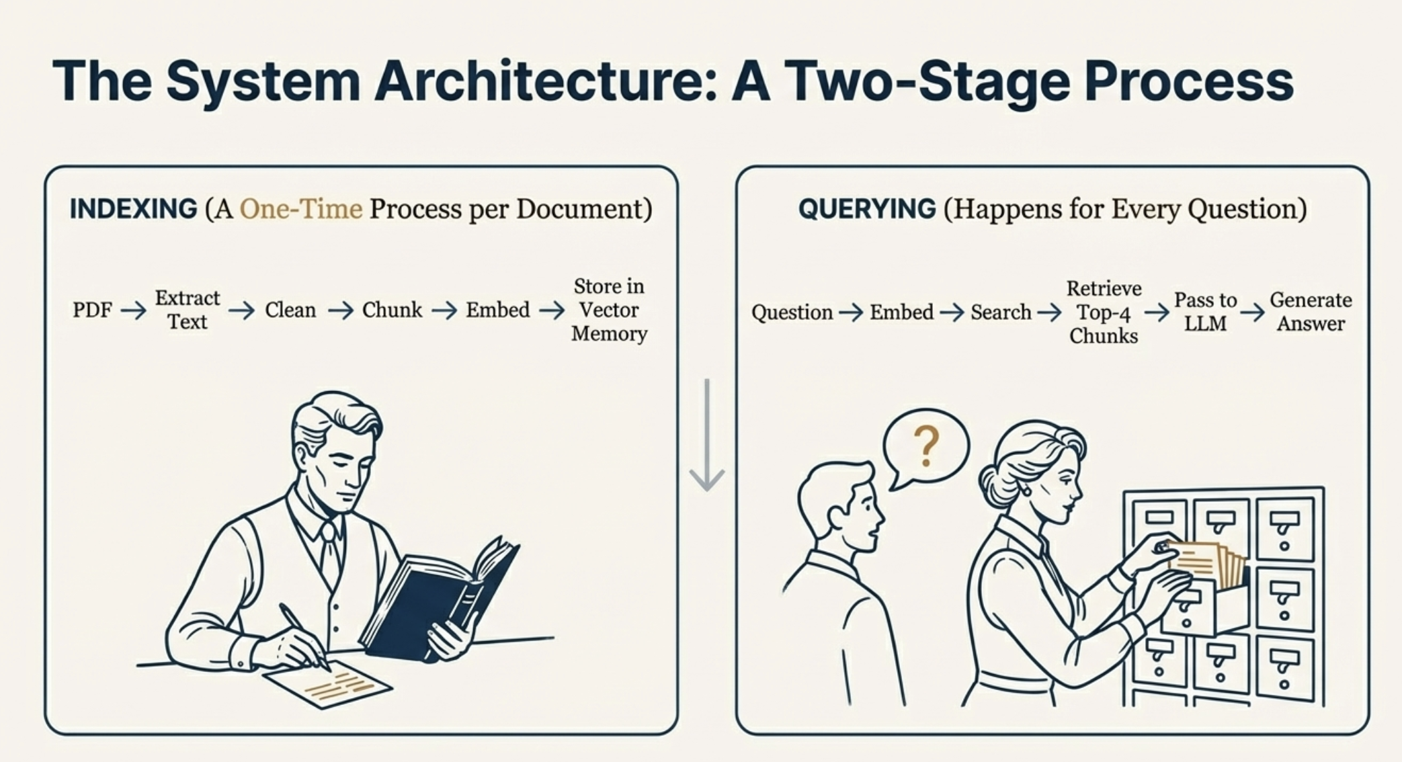
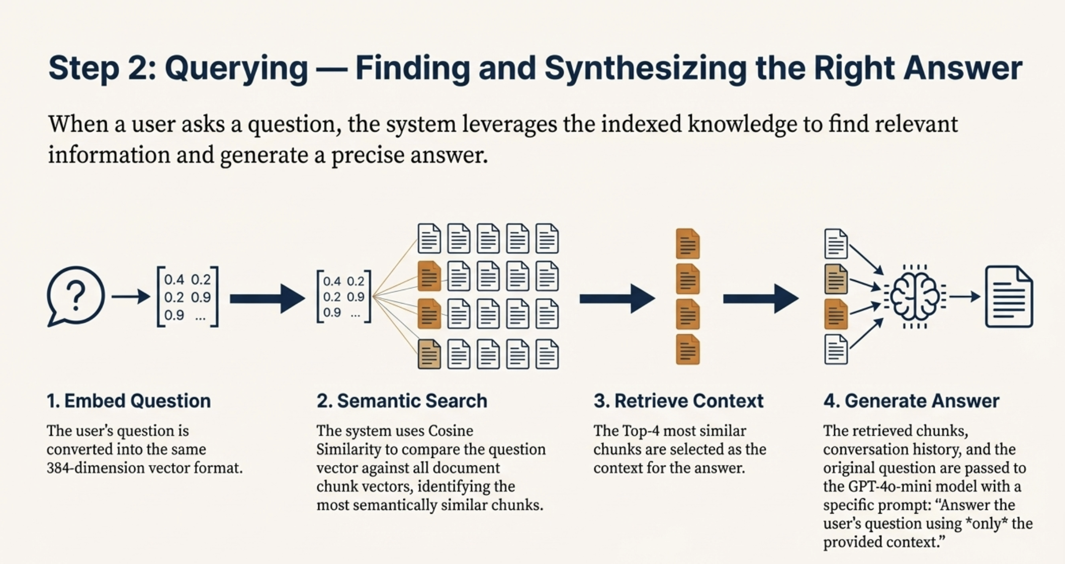

Slide 10

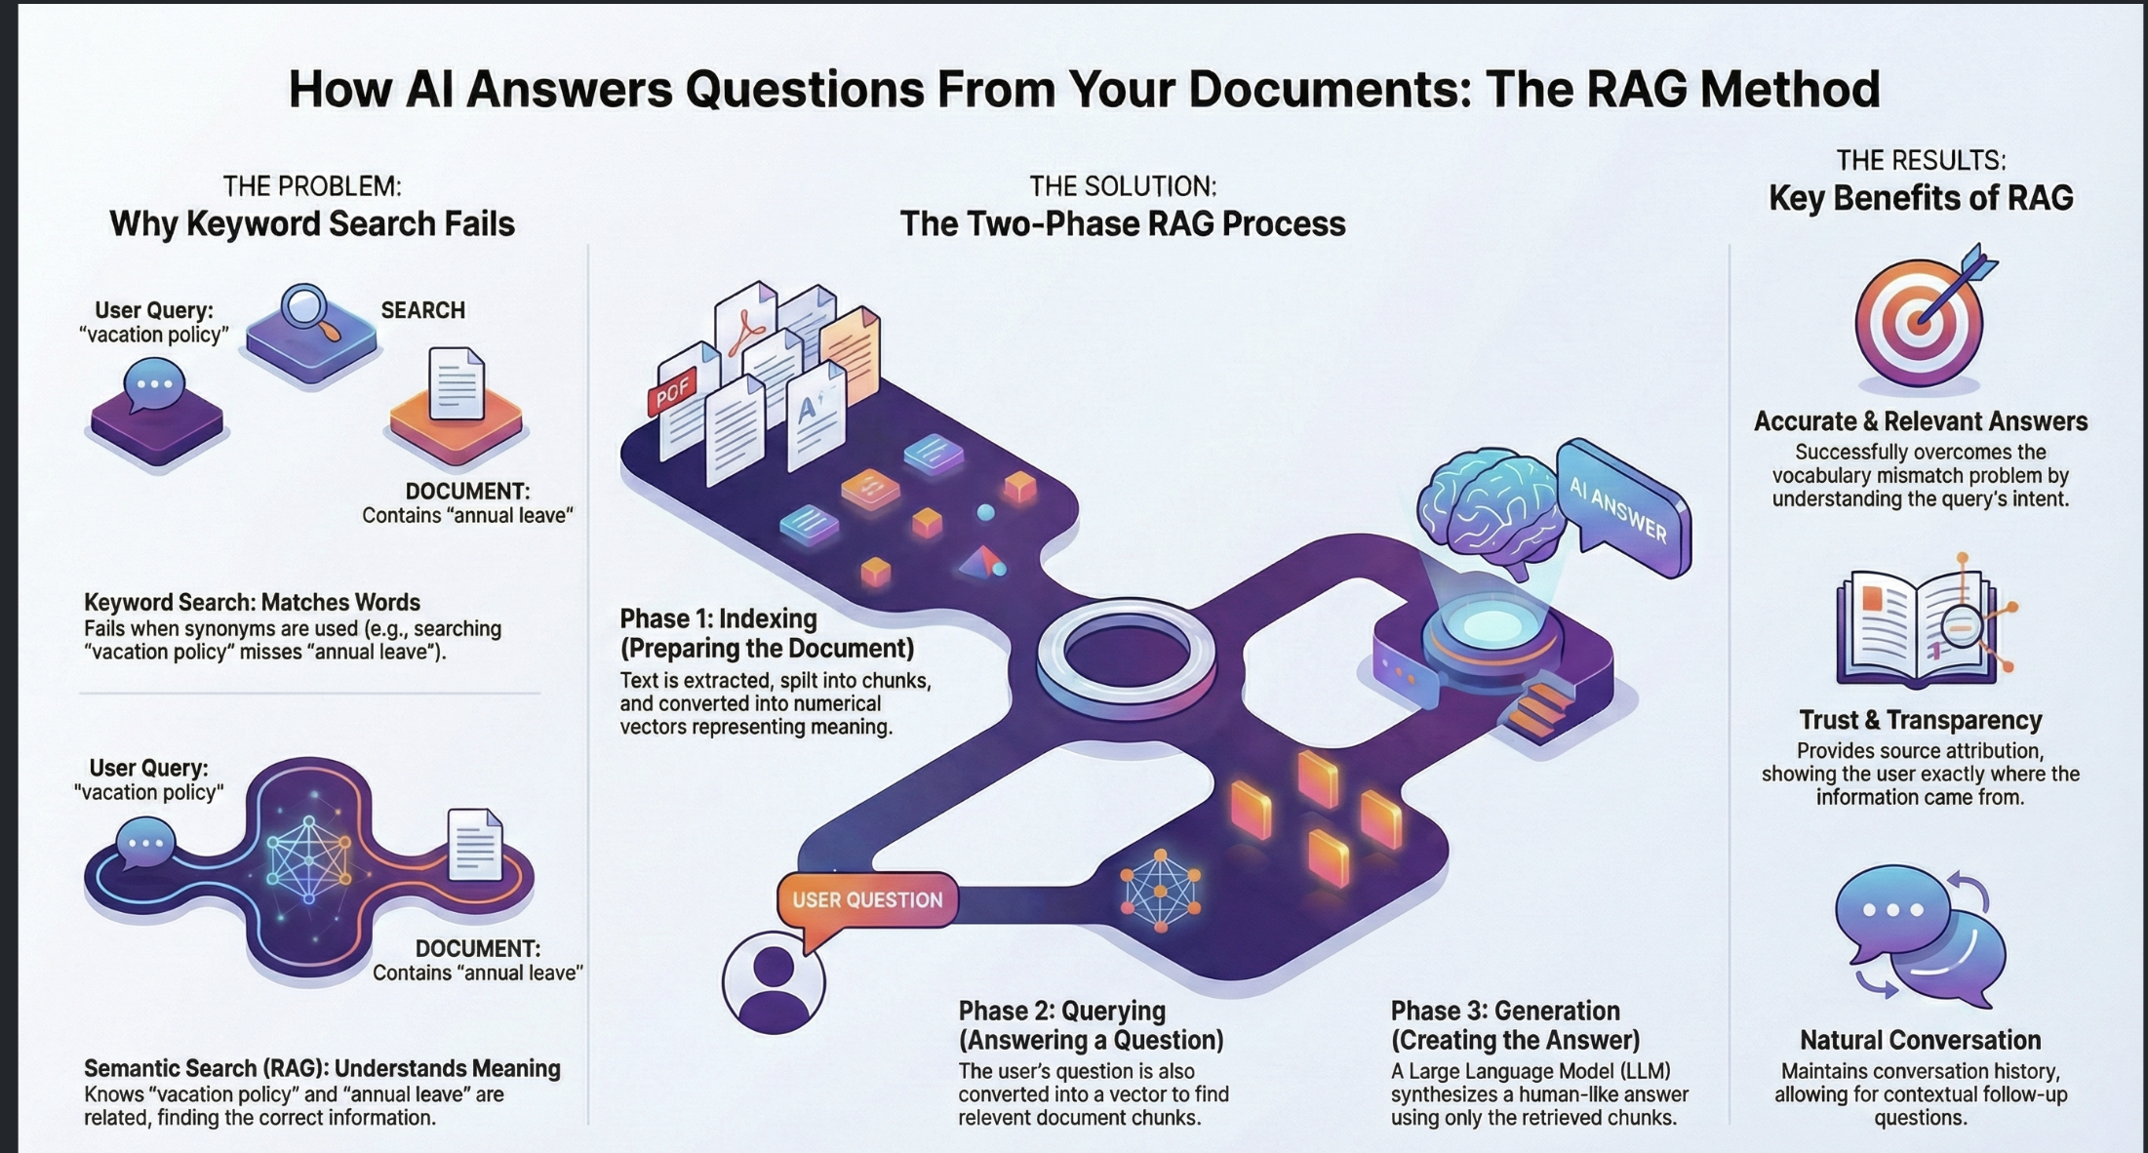




Slide 11
Text Extraction and Preprocessing
PDF documents are first converted into raw text
PDF text often contains noise such as extra spaces and line breaks
Cleaning normalizes the text for downstream NLP tasks
Preprocessing improves embedding quality
PyMuPDF is used for fast and reliable text extraction

Slide 12
Why Chunking Is Necessary
Large documents exceed the context window of language models
Embedding very long text reduces semantic precision
Chunking splits text into manageable semantic units
Each chunk represents a coherent portion of the document
Chunking enables precise retrieval of relevant content

Slide 13
Chunking Strategy Used
Text is split into chunks of approximately 800 characters
Each chunk overlaps by 200 characters with the previous one
Overlap prevents loss of information at boundaries
Chunk size approximates one paragraph of text
This balances retrieval accuracy and computational efficiency

Slide 14
What Are Embeddings
Embeddings are numerical vector representations of text
They capture semantic meaning rather than exact words
Sentences with similar meaning have similar embeddings
Embeddings enable semantic similarity computation
They are a fundamental concept in modern NLP

Slide 15
Why Sentence-Transformers
Sentence-transformers produce sentence-level embeddings
They capture context better than word-level models like Word2Vec
Pretrained models avoid the need for training data
They are efficient and run on CPU
Widely used in industry and research

Slide 16
Answer Generation with LLM
Retrieved chunks are passed as context to the language model
The user question is appended to the prompt
The model is instructed to answer only using provided context
This limits hallucination and improves trust
OpenAI GPT-4o-mini is used for reliable generation

Slide 17
Conversation Memory Handling
Previous user questions and answers are stored
The last three interactions are included in the prompt
This allows natural follow-up questions
Maintains conversational coherence
Balances context depth and API cost

Slide 18
Tools and Technology Choices
Streamlit provides a fast Python-based user interface
Sentence-transformers enable free local embeddings
NumPy efficiently computes vector similarity
OpenAI API offers high-quality text generation
The stack prioritizes simplicity and clarity

Slide 19
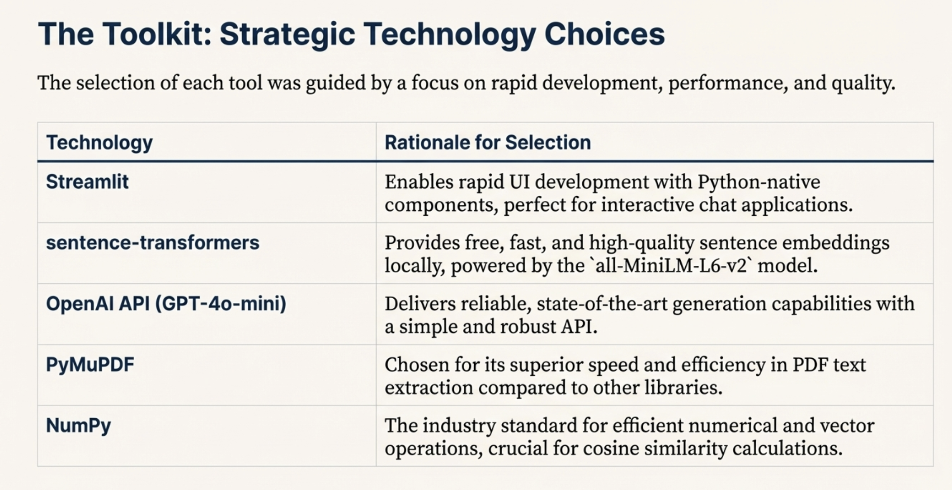

Slide 20
Limitations and Trade-Offs
In-memory storage does not persist data
System depends on external API availability
Only text-based documents are supported
Complex PDFs may extract poorly
Scalability is limited for large datasets

Slide 21
Conclusion & Suggestions
This project demonstrates a complete RAG-based NLP system
It applies embeddings, semantic search, and generation together
The system overcomes keyword search limitations
Design decisions balance simplicity and correctness
The same architecture is used in real-world NLP systems

